Slide 1




Slide 2
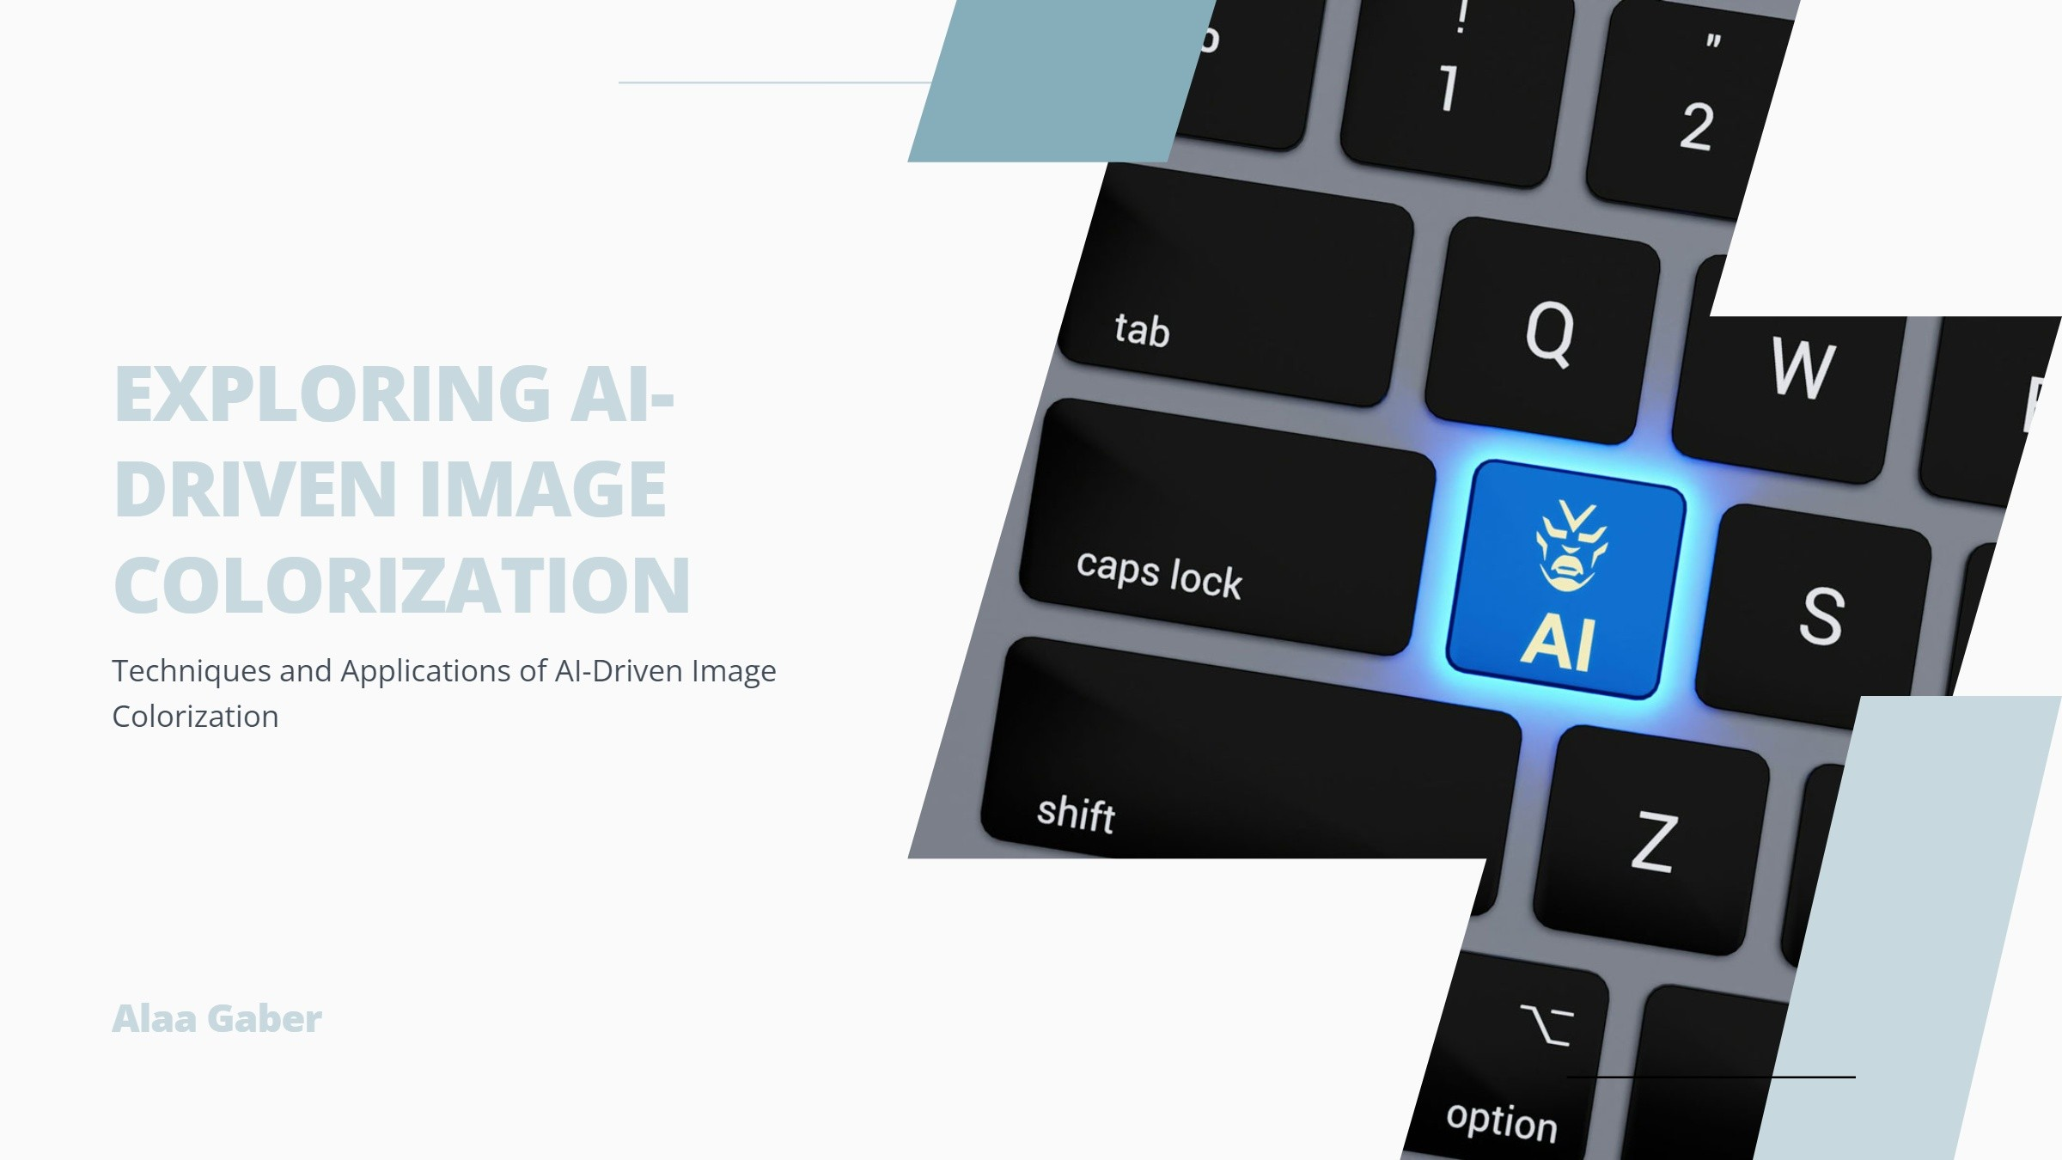

Slide 3
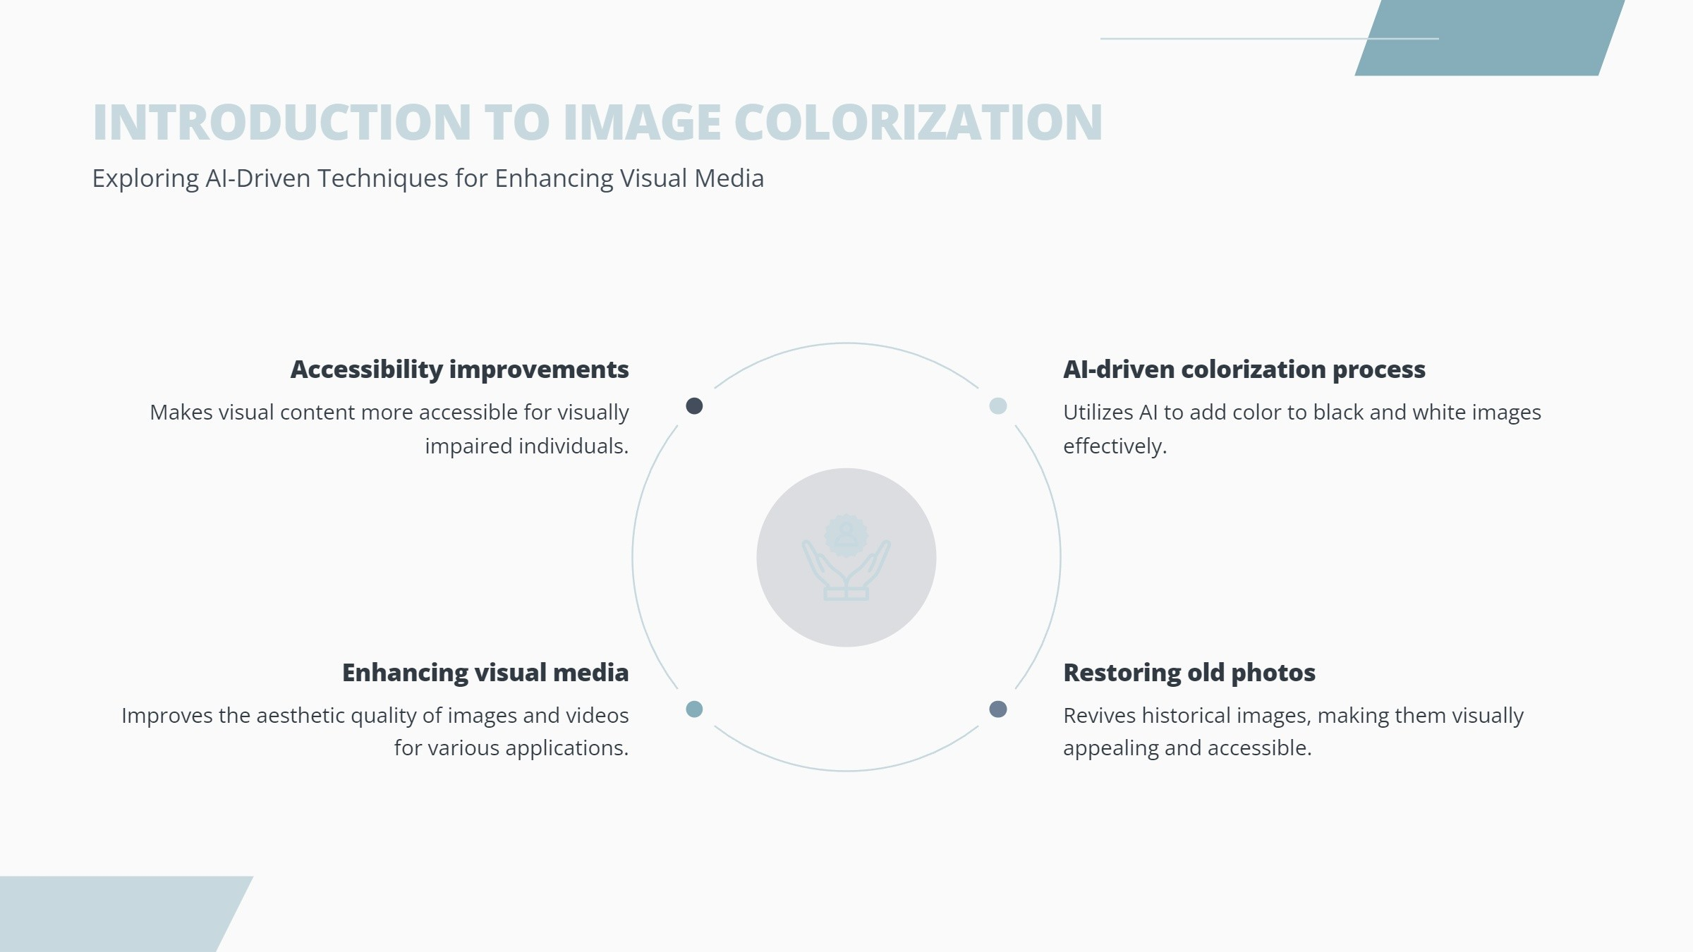

Slide 4
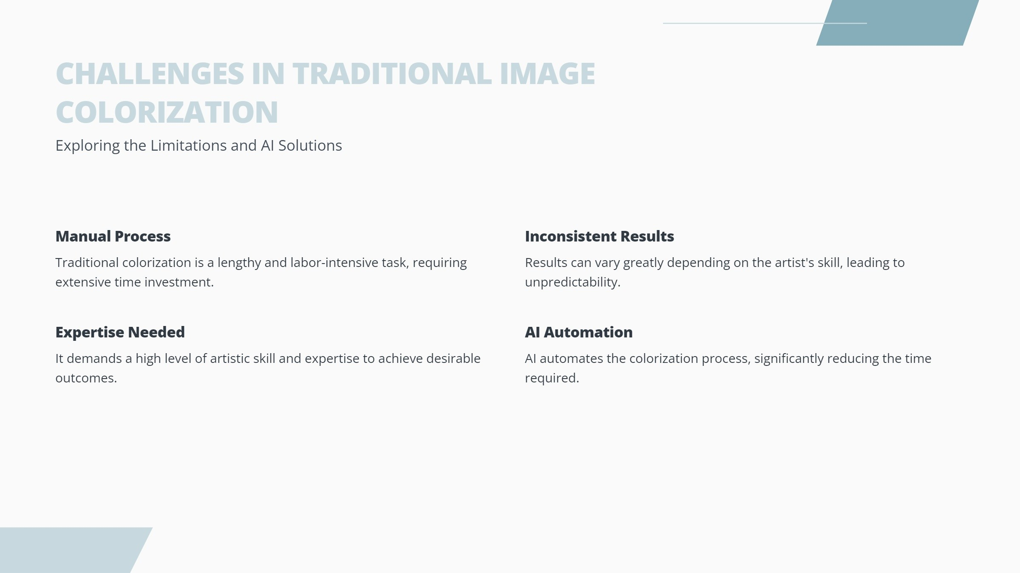

Slide 5
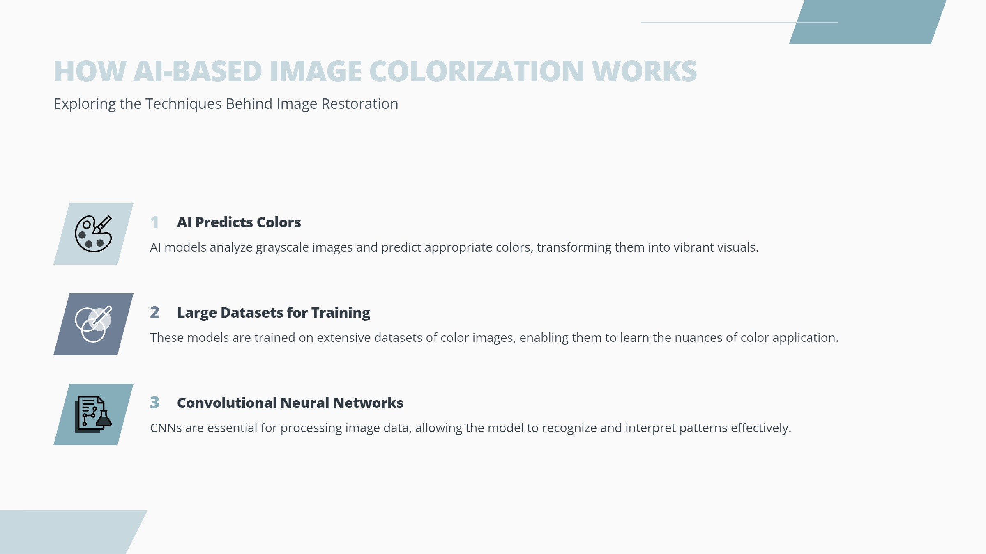

Slide 6
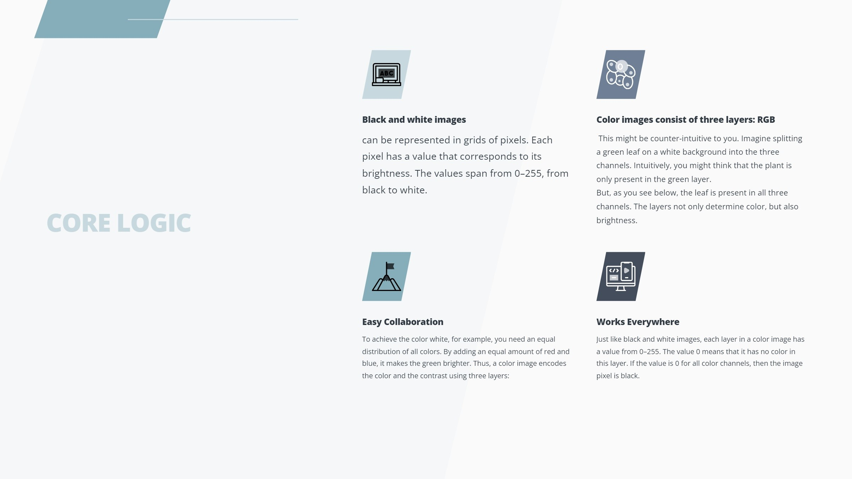
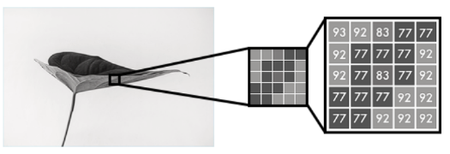
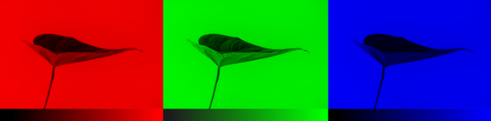
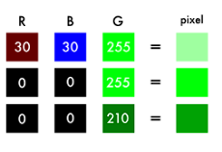
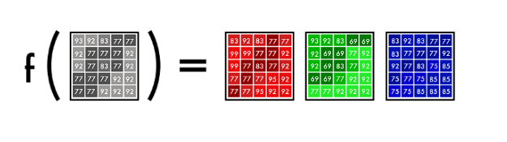

Slide 7
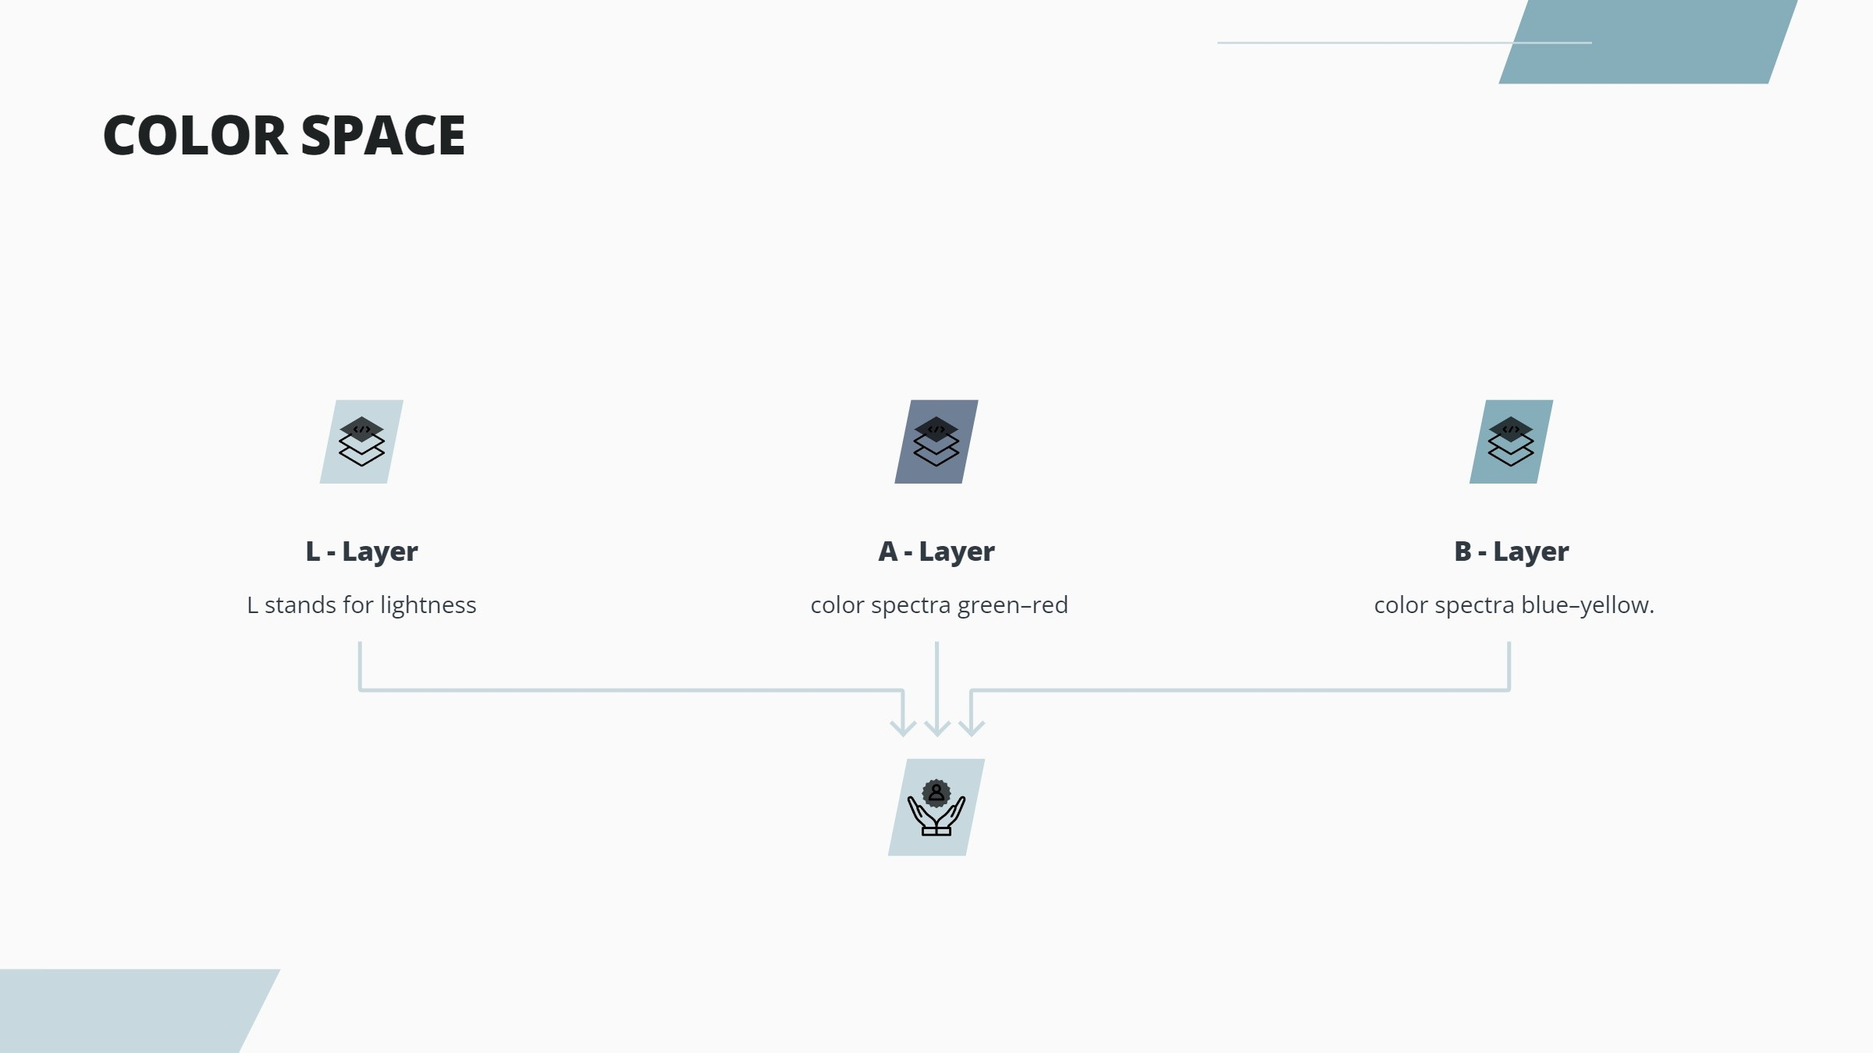
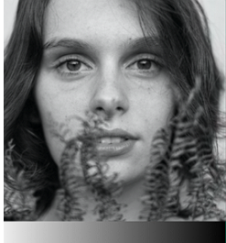
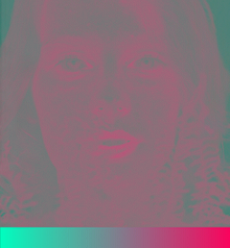
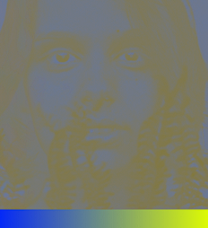

We’ll use an algorithm to change the color channels, from RGB to Lab.
As you can see below, a Lab encoded image has one layer for grayscale and has packed three color layers into two.
This means that we can use the original grayscale image in our final prediction.
Also, we only have two channels to predict.

Slide 8
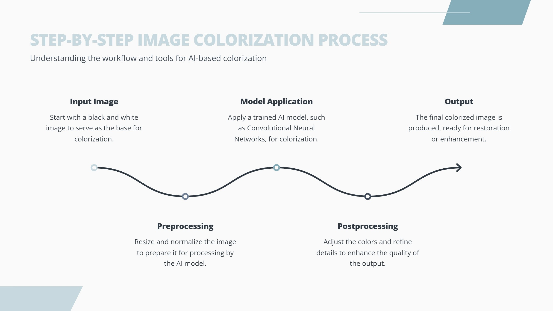

Slide 9
Autoencoder in Image Colorization
What is an Autoencoder?
An autoencoder is a type of neural network used to learn efficient representations (encoding) of data, typically for dimensionality reduction.
It consists of two main parts: an encoder that compresses the input and a decoder that reconstructs the input from the compressed form.
How It Works in Image Colorization:
In image colorization, the autoencoder learns a compressed grayscale representation of the image.
The encoder extracts key features from the grayscale image.
The decoder uses these features to predict and reconstruct the missing color information.
Typically, the L channel (lightness) of the image in Lab color space is fed into the encoder, and the decoder predicts the a and b channels (color information).
Advantages:
The autoencoder learns a low-dimensional representation, which makes it effective for large-scale image colorization tasks.
It helps in capturing complex features from the grayscale image that are crucial for generating accurate color.

Slide 10
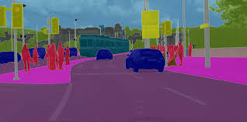
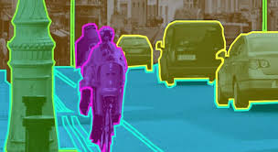
Image Segmentation

Slide 11
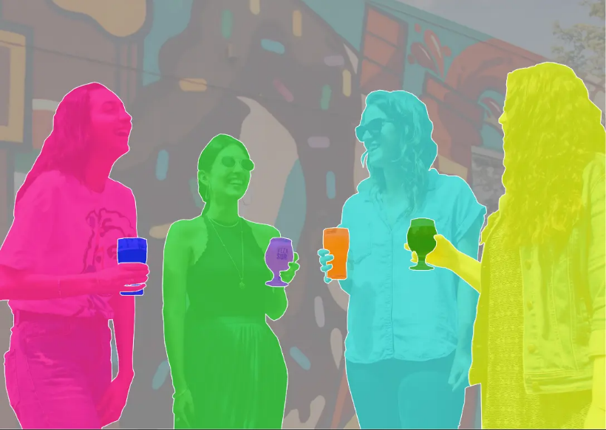
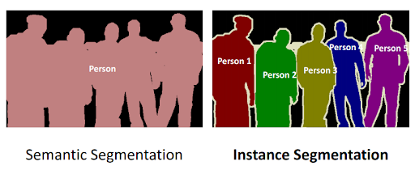
U-Net Semantic Segmentation

Slide 12
U-Net Architecture

Slide 13
Upsampling

Slide 14
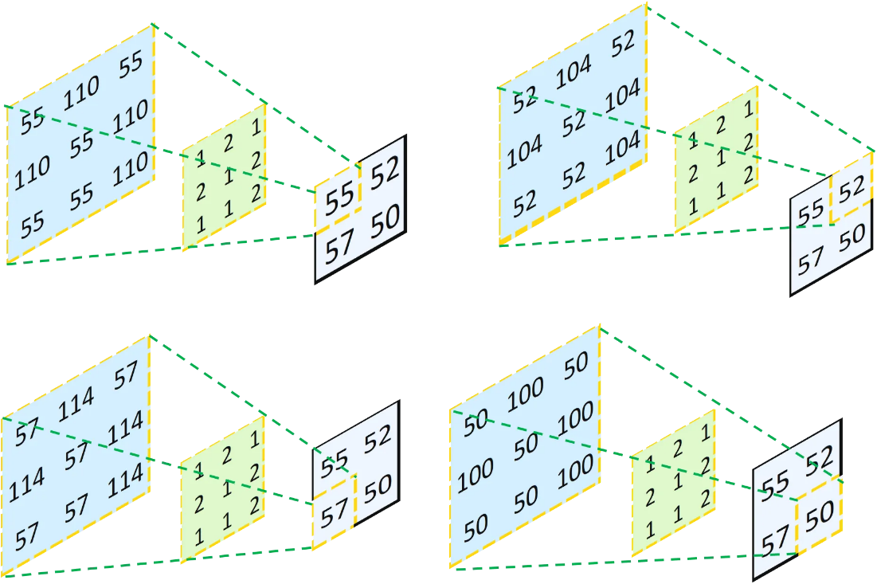
Transpose Convolutional

Slide 15
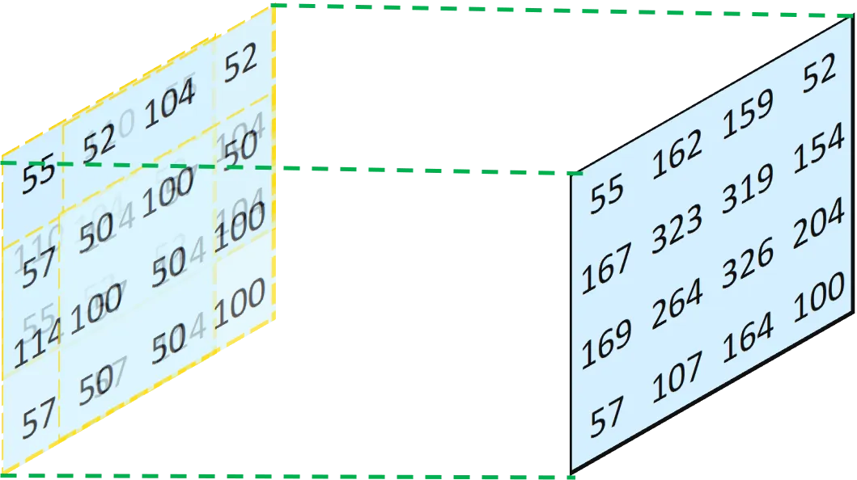
Transpose Convolutional

Slide 16
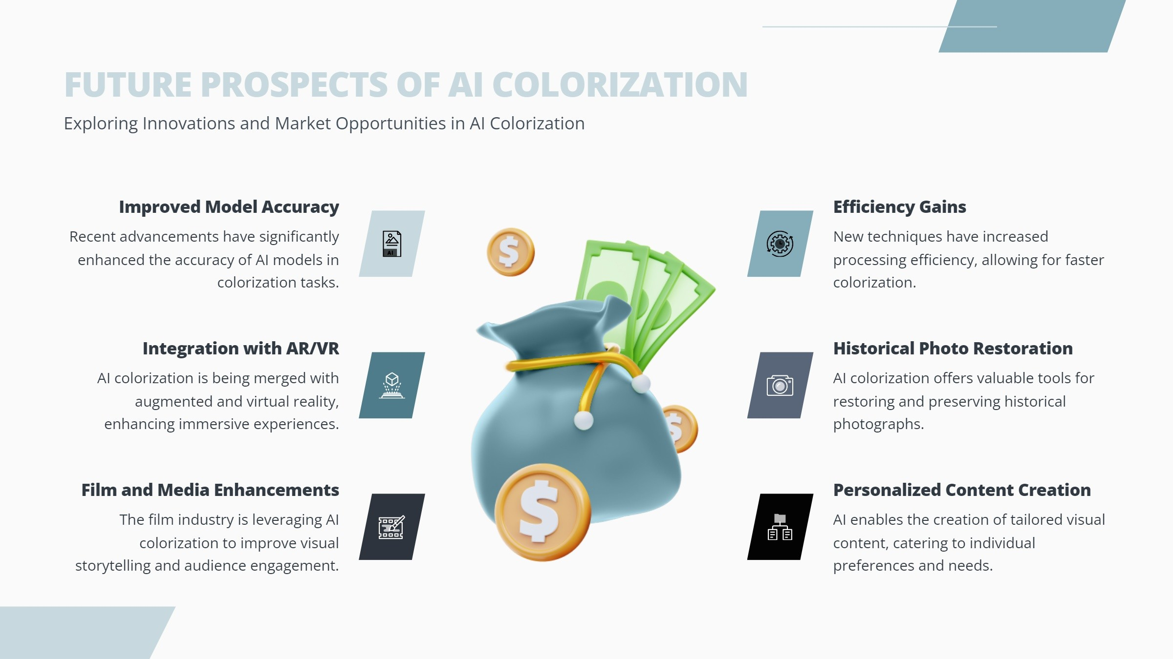

Slide 17
